Slide 1
The z Transfer Function of an LTI system

Slide 2
Introduction
Previously we studied the discrete-time Fourier transform approach for representing discrete signals using complex exponential sequences. This representation clearly has advantages for LTI systems because it describes systems in the frequency domain using the frequency response function H(exp(jω)).
The computation of the sinusoidal steady-state response is greatly facilitated by the use of H(exp(jω)). Furthermore, response to any arbitrary absolutely summable sequence x(n) can easily be computed in the frequency domain by multiplying the transform X(exp(jω)) and the frequency response H(exp(jω)).

Slide 3
Introduction
However, there are two shortcomings to the Fourier transform approach. First, there are many useful signals in practice—such as u(n) and nu(n)—for which the discrete-time Fourier transform does not exist. Second, the transient response of a system due to initial conditions or due to changing inputs cannot be computed using the discrete-time Fourier transform approach.
Therefore we now consider an extension of the discrete-time Fourier transform to address these two problems. This extension is called the z-transform.
It has bilateral (or two-sided) and unilateral (one-sided) versions which provide another domain in which a larger class of sequences and systems can be analyzed, but we only discuss the second version here.

Slide 4
THE BILATERAL z-TRANSFORM
The z-transform of a sequence x(n) is given by
where z is called complex frequency. The set of z values for which X(z)
exists is called the “region of convergence” (ROC) and is given by
for some non-negative numbers Rx− and Rx+ as illustrated in the
following Figure.

Slide 5
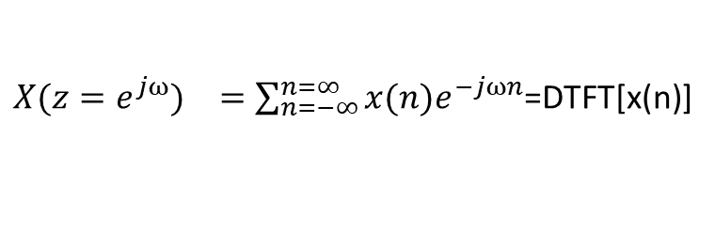
THE BILATERAL z-TRANSFORM
The inverse z-transform of a complex function X(z) is given by
where C is a counterclockwise contour encircling the origin and lying
in the ROC.
The function |z| = 1 (or z = exp(jω)) is a circle of unit radius in the z-plane and is called the unit circle.
If the ROC contains the “unit circle”, then we can evaluate X(z) on the unit circle as
Therefore the discrete-time Fourier transform X(exp(jω)) may be viewed as a special case of the z-transform X(z).
${X(z=e^{jω})}^{}=\sum_{n=−∞}^{n=∞}{x(n)e^{−jωn}}$=DTFT[x(n)]

Slide 6
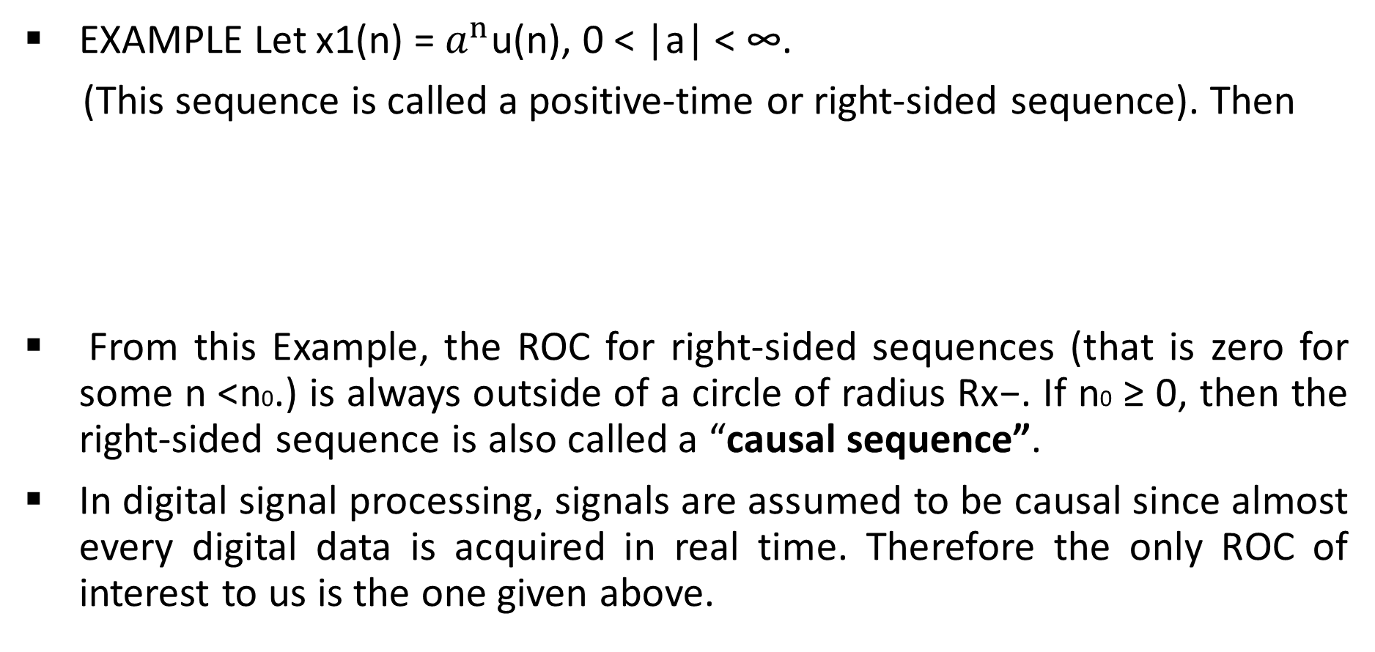
THE BILATERAL z-TRANSFORM
EXAMPLE Let x1(n) = $a^{n}$u(n), 0 < |a| < ∞.
(This sequence is called a positive-time or right-sided sequence). Then
From this Example, the ROC for right-sided sequences (that is zero for some n <n0.) is always outside of a circle of radius Rx−. If n0 ≥ 0, then the right-sided sequence is also called a “causal sequence”.
In digital signal processing, signals are assumed to be causal since almost every digital data is acquired in real time. Therefore the only ROC of interest to us is the one given above.

Slide 7
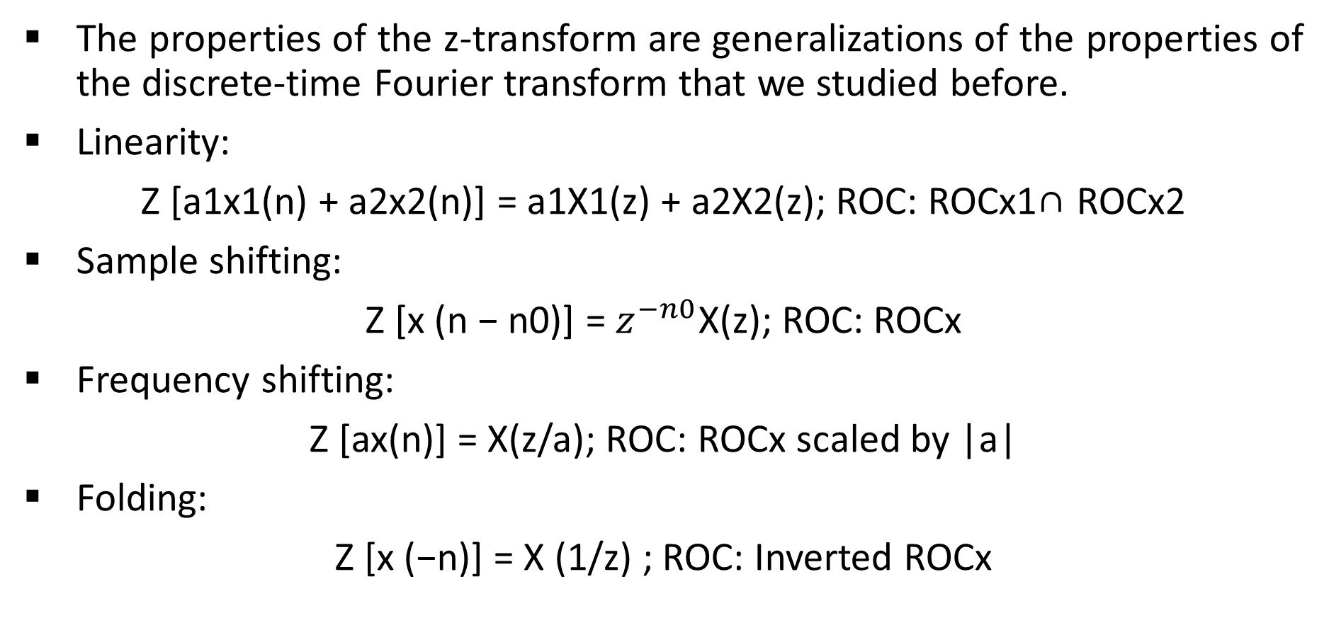
IMPORTANT PROPERTIES OF THE z-TRANSFORM
The properties of the z-transform are generalizations of the properties of the discrete-time Fourier transform that we studied before.
Linearity:
Z [a1x1(n) + a2x2(n)] = a1X1(z) + a2X2(z); ROC: ROCx1∩ ROCx2
Sample shifting:
Z [x (n − n0)] = $z^{−n0}$X(z); ROC: ROCx
Frequency shifting:
Z [ax(n)] = X(z/a); ROC: ROCx scaled by |a|
Folding:
Z [x (−n)] = X (1/z) ; ROC: Inverted ROCx

Slide 8
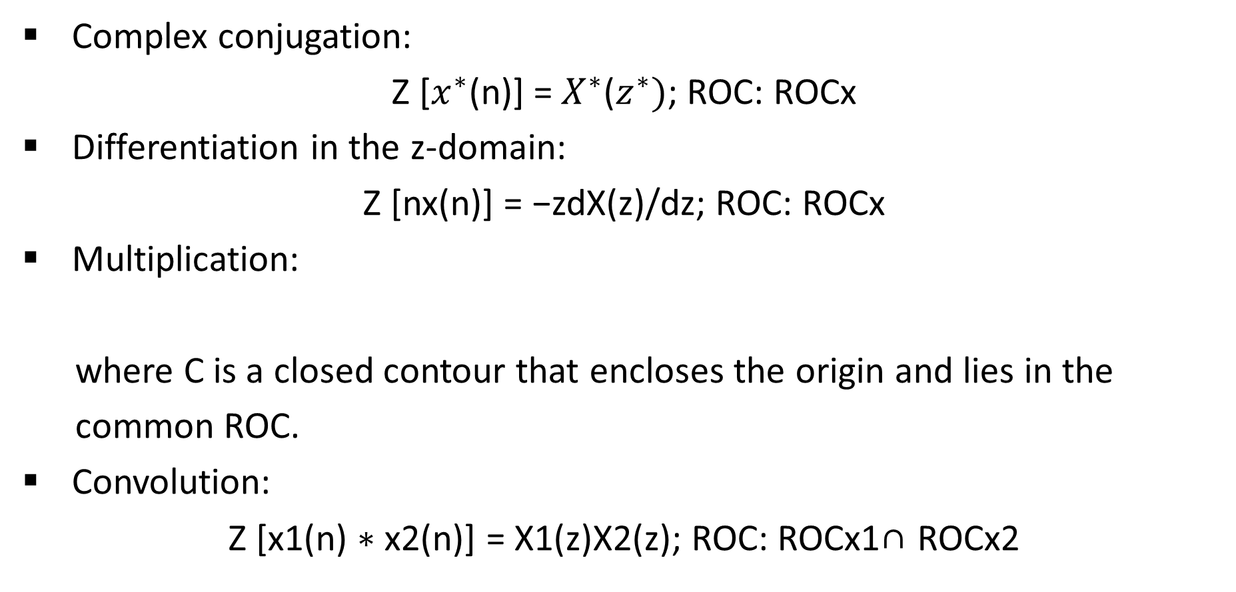
IMPORTANT PROPERTIES OF THE z-TRANSFORM
Complex conjugation:
Z [$x^{∗}$(n)] = $X^{∗}$($z^{∗})$; ROC: ROCx
Differentiation in the z-domain:
Z [nx(n)] = −zdX(z)/dz; ROC: ROCx
Multiplication:
where C is a closed contour that encloses the origin and lies in the
common ROC.
Convolution:
Z [x1(n) ∗ x2(n)] = X1(z)X2(z); ROC: ROCx1∩ ROCx2

Slide 9
SOME COMMON z-TRANSFORM PAIRS
Using the definition of z-transform and its properties, one can determine
z-transforms of common sequences. A list of some of these sequences is
given in the following Table.

Slide 10
INVERSION OF THE z-TRANSFORM
Regarding the given formula, the inverse z-transform computation requires an evaluation of a complex contour integral that, in general, is a complicated procedure.
The most practical approach is to use the “partial fraction expansion” method. It makes use of the z-transform Table mentioned in the previous slide.
The z-transform, however, must be a “rational function”. This requirement is generally satisfied in digital signal processing.
Given the rational function

Slide 11
INVERSION OF THE z-TRANSFORM
Perform a partial fraction expansion on the proper rational part of X(z) to obtain
where pk is the kth pole of X(z) and Rk is the residue at pk.
Assuming distinct poles, write x(n) as
Finally, use the relation from the z-transform Table to complete x(n).

Slide 12
INVERSION OF THE z-TRANSFORM
EXAMPLE Find the inverse z-transform of right-sided signal
Solution: Write
or
Now, X(z) has two poles: z1 = 1 and z2 = 1/3 ; and since the signal is
right-sided then

Slide 13
The pole-zero plot of a LTI system
Similar to the frequency response function H(exp(jω)), we can define the z-domain function, H(z), as the system function. However, unlike H(exp(jω)), H(z) exists for systems that may not be BIBO stable.
The system function H(z) is given by
Using the convolution property of the z-transform, the output transform Y (z) is given by
Y (z) = H(z) X(z) : ROCy= ROCh ∩ ROCx

Slide 14
The pole-zero plot of a LTI system
When LTI systems are described by a difference equation
the system function H(z) can easily be computed.
Taking the z-transform of both sides, and using properties of the z-transform, and after factorization, we obtain
where zs are the “system zeros” and pk’s are the “system poles”.
Thus H(z) (and hence an LTI system) can also be represented in the z-domain using a pole-zero plot. This fact is useful in “designing simple filters” by proper placement of poles and zeros.

Slide 15
TRANSFER FUNCTION REPRESENTATION
If the ROC of H(z) includes a unit circle (z = exp(jω)), then we can evaluate H(z) on the unit circle, resulting in a frequency response function or transfer function H(exp(jω)) as
The factor (exp(jω)−zl) can be interpreted as a vector in the complex z-plane from a zero zl to the unit circle at z = exp(jω), while the factor (exp(jω) − pk) can be interpreted as a vector from a pole pk to the unit circle at z = exp(jω). This is shown in the following Figure.

Slide 16
The magnitude & phase plots of Fourier transforms based on the pole-zero sketch of a LTI system
Hence the magnitude response function
can be interpreted as a product of the lengths of vectors from zeros to
the unit circle divided by the lengths of vectors from poles to the unit
circle and scaled by |b0|.

Slide 17
The magnitude& & phase plots of Fourier transforms based on the pole-zero sketch of a LTI system
Similarly, the phase response function can be interpreted as a sum of a constant factor, a linear-phase factor, and a nonlinear-phase factor (angles from the “zero vectors” minus the sum of angles from the “pole vectors”).

Slide 18
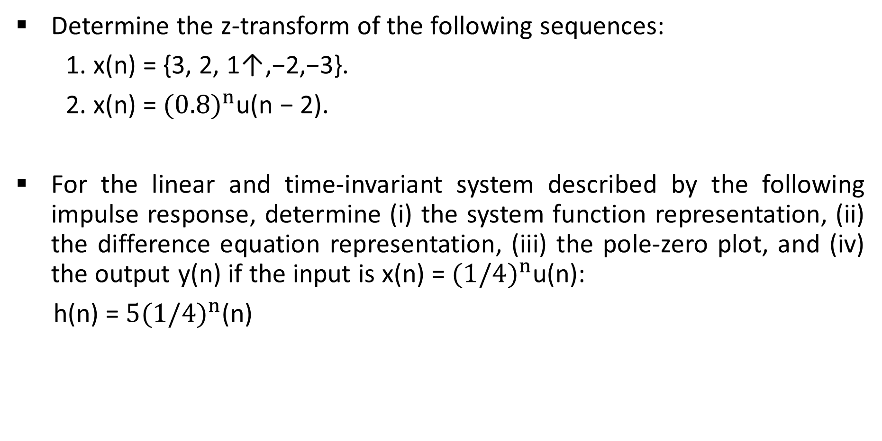
Problems
Determine the z-transform of the following sequences:
1. x(n) = {3, 2, 1↑,−2,−3}.
2. x(n) = ${(0.8)}^{n}$u(n − 2).
For the linear and time-invariant system described by the following impulse response, determine (i) the system function representation, (ii) the difference equation representation, (iii) the pole-zero plot, and (iv) the output y(n) if the input is x(n) = ${(1/4)}^{n}$u(n):
h(n) = ${5(1/4)}^{n}$(n)

